Slide 1
OOD - group 12
OOAD Spring-2020-A5.1

Slide 2
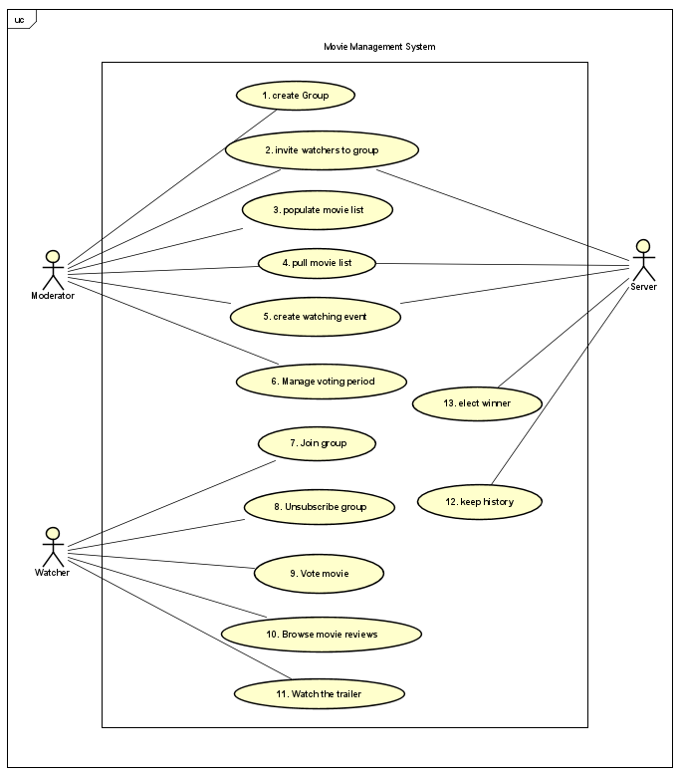
Use case diagram

Slide 3
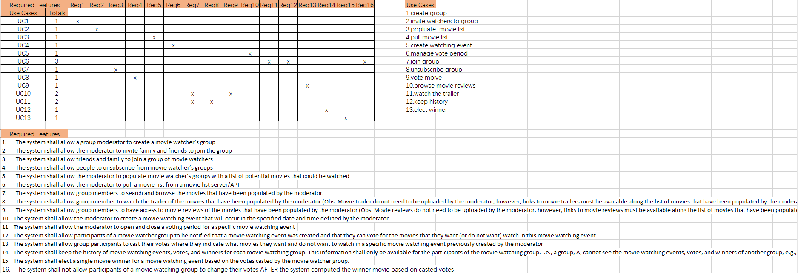
Bi-Direction Traceability Matrix Between the Required Features and the Use Cases

Slide 4
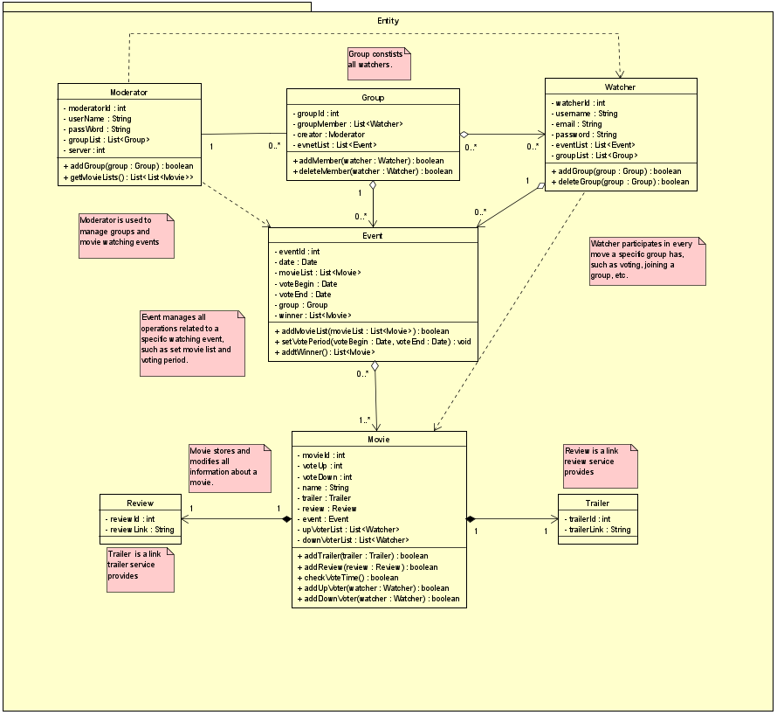
MVC packages-Entity

Slide 5
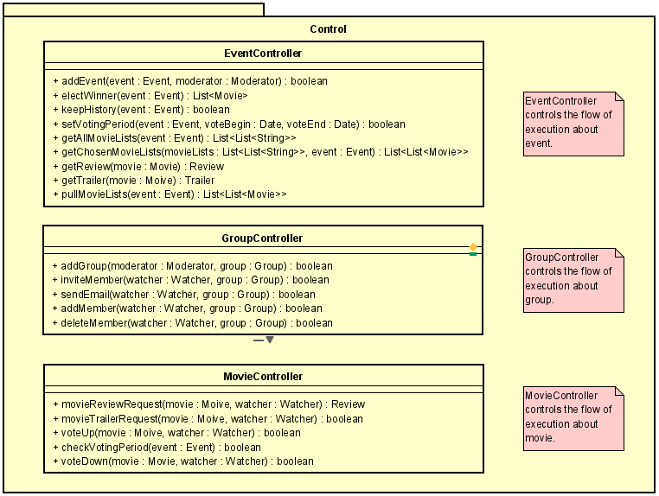
MVC packages-
Control

Slide 6
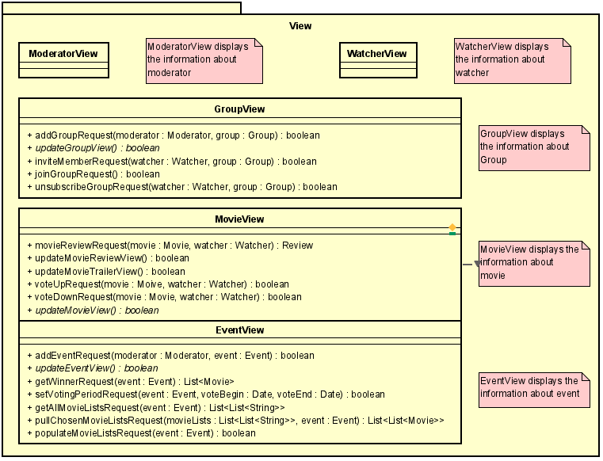
MVC packages-
View

Slide 7
Use Case 1
Use Case ID: 1
Use Case Name: Create group
Actors：Moderator
Description: The moderator creates a movie watcher’s group with a specific group name.
Preconditions: Enter the username and password to login as a moderator.
Post conditions: The system has stored the group the moderator just created.
Steps:
Step 1: The moderator creates a new group with a specific group name.
Step 2: The moderator can optionally enter the number of group member.
Step 3: The moderator clicks “Create group” button to finish.

Slide 8
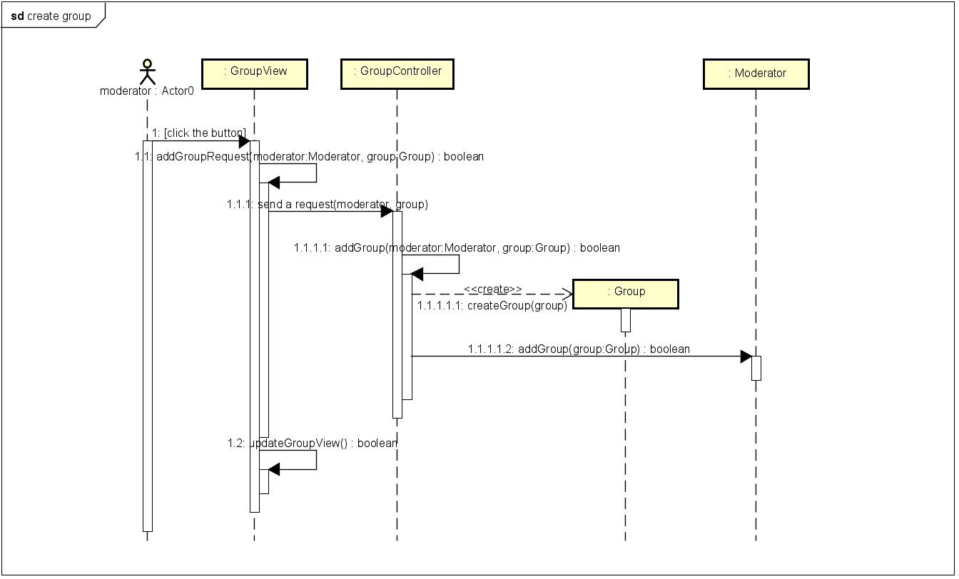
Sequential Diagram 1: Create group

Slide 9
Use Case 2
Use Case ID: 2
Use Case Name: Invite watchers to Group
Actors：Moderator, Server
Description: The moderator invites friends and families to join the group. To invite the participants,
the system will send emails to people who have been invited.
Preconditions: The group has already been created.
Post conditions: The system has sent the emails to group members who have been invited.
Steps:
Step 1: The moderator enter watchers’ emails to invite them to join the group.
Step 3: The moderator clicks “Invite friends” button to notify the system to send the emails.
Step 2: The system sends emails to watchers.

Slide 10
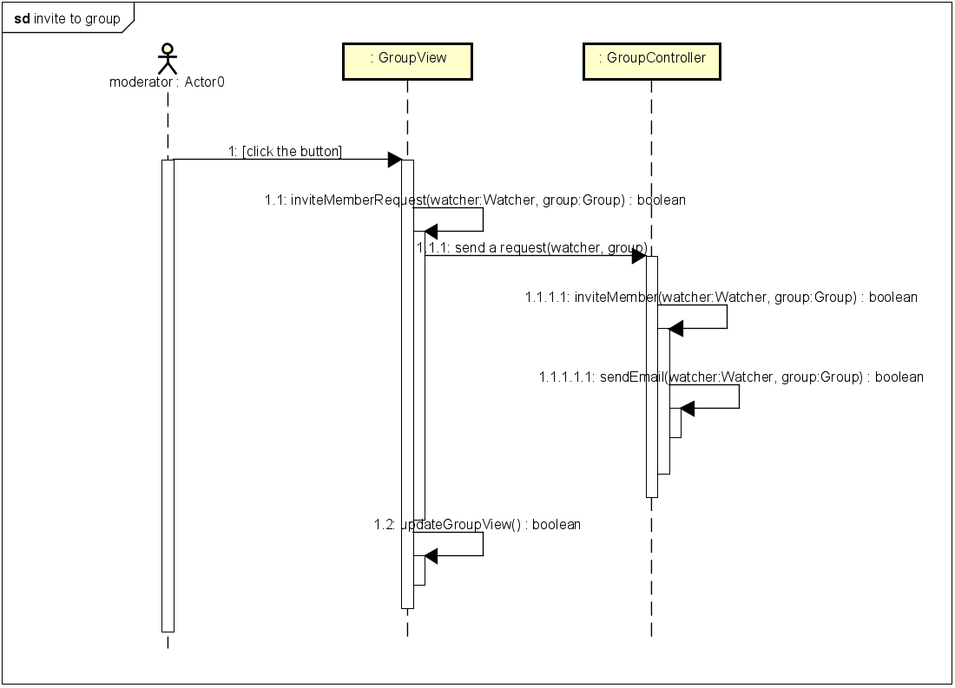
Sequential Diagram 2: Invite watchers to group

Slide 11
Use Case 3
Use Case ID: 3
Use Case Name: Populate movie list
Actors：Moderator
Description: The moderator adds the movie list to a specific group, which contains the
movies this group will vote eventually.
Preconditions: The specific group has been selected.
Post conditions: The movie list has already added to a specific group.
Steps:
Step 1: The moderator checks whether ths movie list has already existed.
Step 2: If the movie list exists, the moderator populates it directly, otherwise, pulls the movie list.
Step 3: The moderator click the “populate movie list” button to finish.

Slide 12
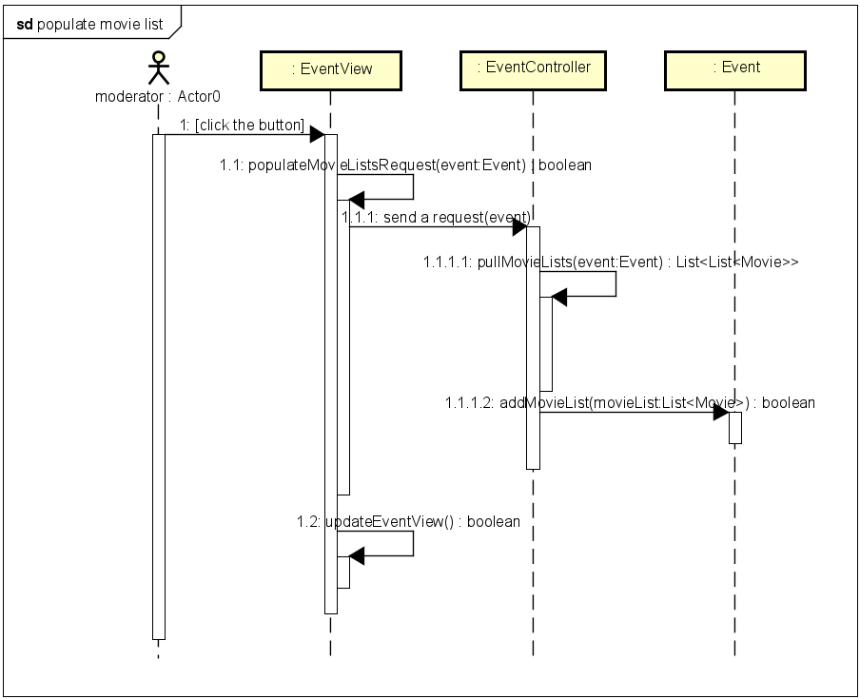
Sequential Diagram 3: Populate movie list

Slide 13
Use Case 4
Use Case ID: 4
Use Case Name: Pull movie list
Actors：Moderator, Server
Description: The moderator pulls movie list from a movie list server/API.
Preconditions: The connection to the server is successful.
Post conditions: The movie list has already been pulled.
Steps:
Step 1: The moderator asks the server for the list of movie list.
Step 2: The moderator chooses a movie list which he thinks is suitable for this group.
Step3: The moderator click “pull movie list” button to finish.

Slide 14
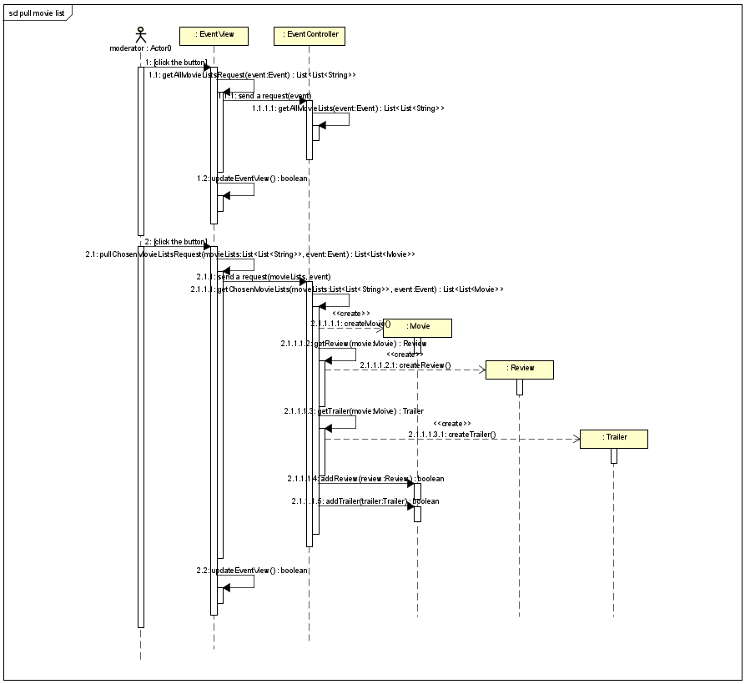
Sequential Diagram 4: Pull movie list

Slide 15
Use Case 5
Use Case ID: 5
Use Case Name: Create watching event
Actors：Moderator, Server
Description: The moderator sets the details of the watching event, including the date
and time the watching event begins, besides, the movies in the watching event.
Preconditions: The group has been created.
Post conditions: The system has stored the watching event the moderator just created.
Steps:
Step 1: A specific Id of the watching event is set.
Step 2: The moderator sets a specific time and other details for the watching event.
Step 3: The moderator clicks “create event” button to finish.
Step 4: The system notifies the watchers that a new watching event has been created.

Slide 16
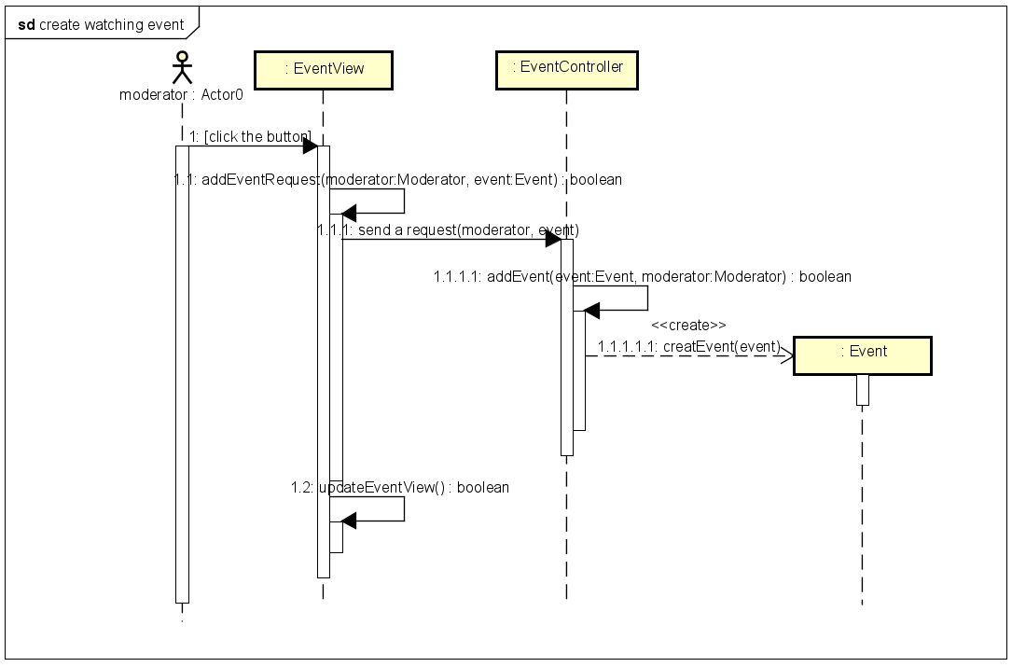
Sequential Diagram 5: Create watching event

Slide 17
Use Case 6
Use Case ID: 6
Use Case Name: Manage voting period
Actors：Moderator
Description: The moderator sets the open time and close time of the voting period related to the
specific movie list and then lets the system notify all members of the group when the
voting begins.
Preconditions: The group and movie event has been created.
Post conditions: The system has calculated the vote that each movie gets, and helps moderator to
select which movie to watch.
Steps:
Step 1: The moderator sets the time to open the voting.
Step 2: The moderator sets the time to close the voting.
Step 3: The moderator clicks “set voing” button to finish.
Step 3: The system notifies the watchers of voting period.

Slide 18
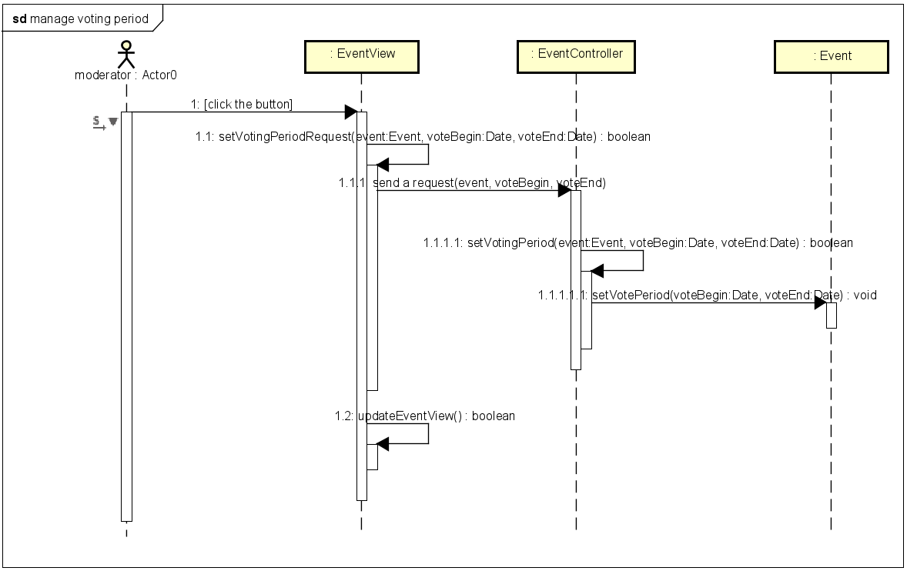
Sequential Diagram 6: Manage voting period

Slide 19
Use Case 7
Use Case ID: 7
Use Case Name: Join group
Actors：Watcher
Description: Watchers will receive the invitation the moderator sends, and then decide whether to
join the specific movie group.
Preconditions: The system has sent watchers invitations to join the group.
Post conditions: The system has added the watcher to the group created by the moderator.
Steps:
Step 1: The watcher receives an email invitation
Step 2: The watcher opens the link to agree to join the group.
Step 3: The system notifies the other participants that the specific watcher has joined
the group.

Slide 20
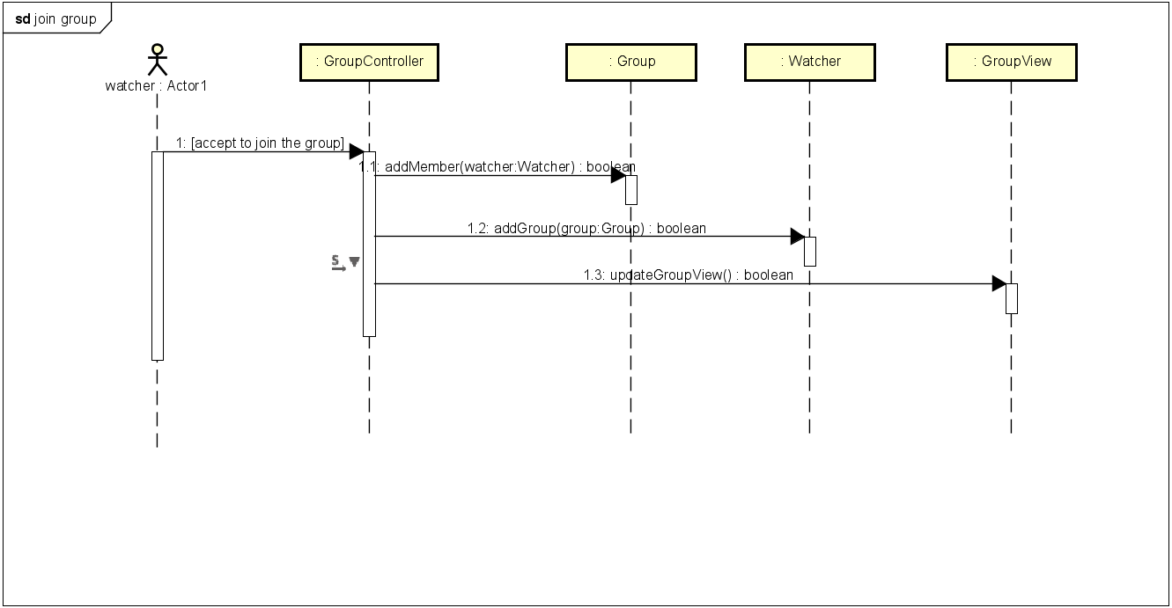
Sequential Diagram 7: Join group

Slide 21
Use Case 8
Use Case ID: 8
Use Case Name: Unsubscribe group
Actors：Watcher
Description: Watchers can unsubscribe from the specific movie watcher’s group.
Preconditions: The watcher has already joined a group.
Post conditions: The system has removed the watcher from the group.
Steps:
Step 1: The watcher clicks the button to unsubscribe a group.
Step 2: The watcher is removed from the group member list.
Step 3: The system notifies the other participants that the specific watcher has left the
group.

Slide 22
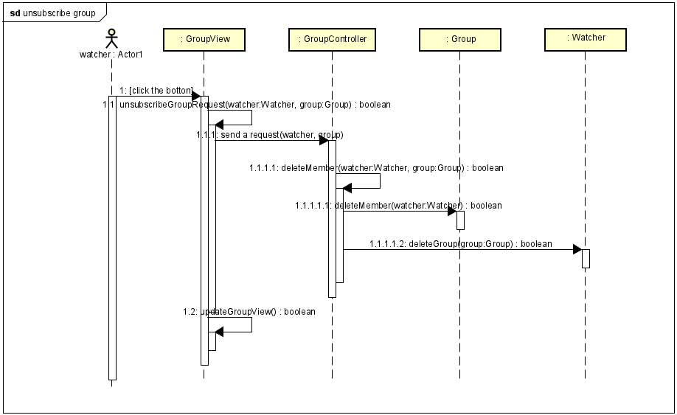
Sequential Diagram 8: Unsubscribe group

Slide 23
Use Case 9
Use Case ID: 9
Use Case Name: Vote movie
Actors：Watcher
Description: Watchers votes only one movie he wants to watch later. He can change the
the vote anytime before the voting periods end.
Preconditions: The watcher has already joined a specific movie event and the voting period has
opened.
Post conditions: The system has kept the vote.
Steps:
Step 1: The watcher selects the movie he wants to watch.
Step 2: The watcher clicks “vote” button to vote for the selected movie.

Slide 24
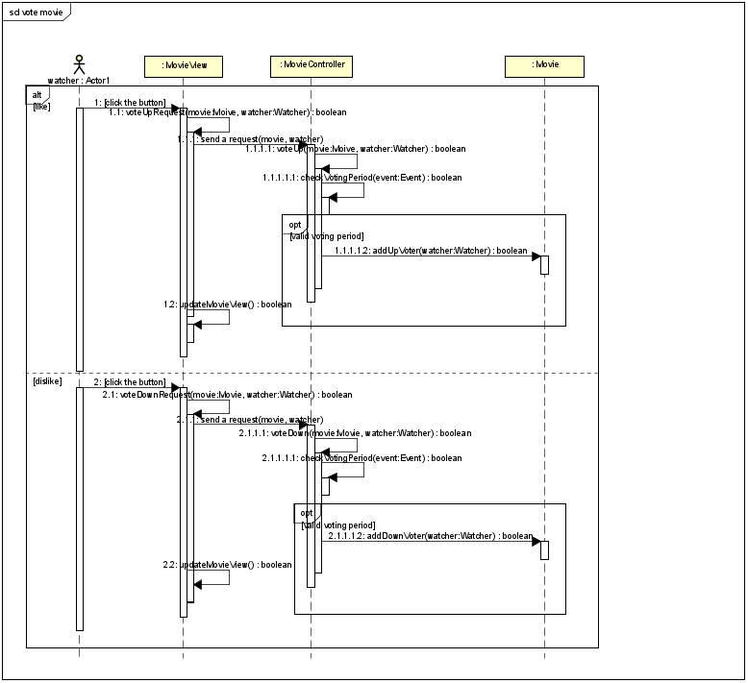
Sequential Diagram 9: Vote movie

Slide 25
Use Case 10
Use Case ID: 10
Use Case Name: Browse movie reviews
Actors：Watcher
Description: Watchers can browse movies reviews for the selected movie in the movie list.
Preconditions: The watcher has already selected a movie.
The connection to the server is successful.
Post conditions: The server has retured the movie reviews to the watcher.
Steps:
Step 1: The watcher clicks the “browse reviews” button to asks the server for the reviews.
Step 2: The server has returned the reviews.

Slide 26
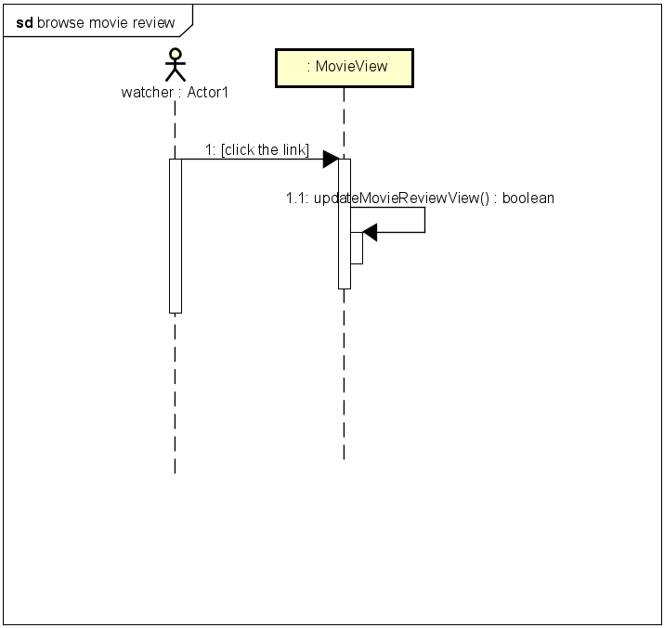
Sequential Diagram 10: Browse movie reviews

Slide 27
Use Case 11
Use Case ID: 11
Use Case Name: Watch the trailer
Actors：Watcher
Description: Watchers can watch trailers for the selected movie in the movie list.
Preconditions: The watcher has already selected a movie.
The connection to the server is successful.
Post conditions: The server has retured the movie trailers to the watcher.
Steps:
Step 1: The watcher clicks the “watch trailers” button to asks the server for the trailers.
Step 2: The server has returned the trailers.

Slide 28
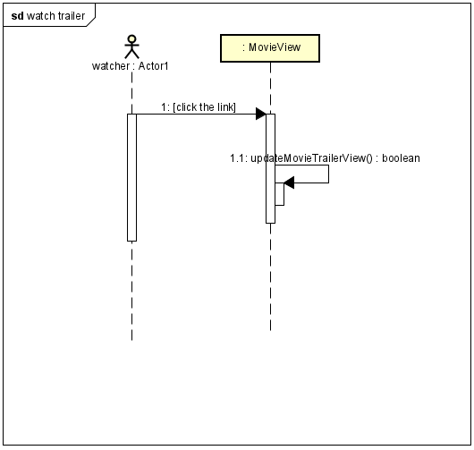
Sequential Diagram 11: Watch the trailer

Slide 29
Use Case 12
Use Case ID: 12
Use Case Name: Keep history
Actors: Server
Description: The server keeps everything in record, including the movie watching events, votes, and
winners for each movie watching group.
Preconditions: The moderator has already created the watching events.
The watchers have already voted.
The winners have already been elected.
Post conditions: The system has kept everything in the memory.
Steps:
Step 1: The system stores the information of the movie event, group, vote and the result.
Step 2: The system sends the history to the watchers of the specific group.

Slide 30
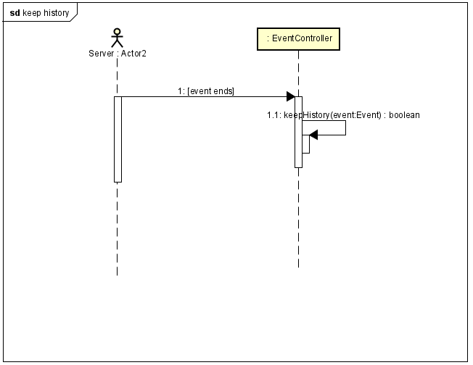
Sequential Diagram 12: Keep history

Slide 31
Use Case 13
Use Case ID: 13
Use Case Name: Elect winner
Actors: Server
Description: The system collects the voting information and selects the one with the highest votes.
Preconditions: The watcher has already voted.
Post conditions: The system has selected the winner.
Steps:
Step 1: The system gets voting information.
Step 2: The system selects the movie which has the highest vote.
Step 3: The system sends the voting results to watchers.

Slide 32
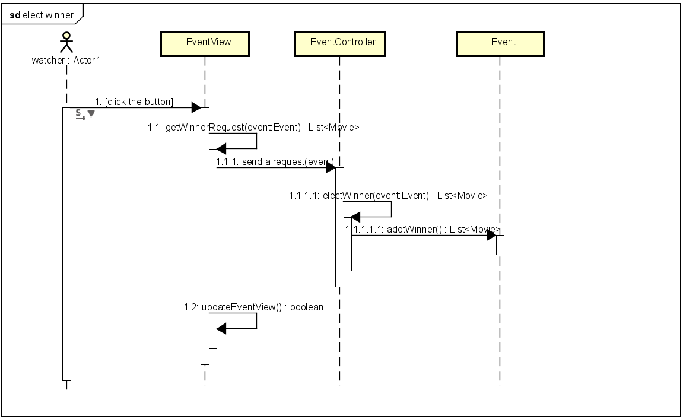
Sequential Diagram 13: Elect winner

Slide 33
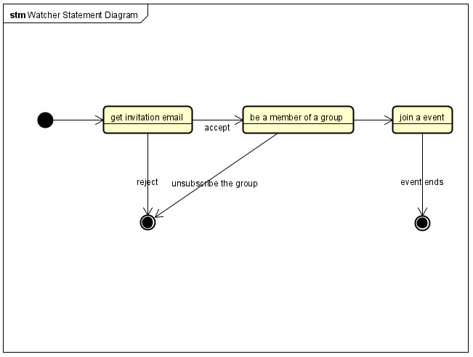
State Diagram

